Slide 1


a
Hindu Institute of
Management
Power of Social Media
Represented by: – Shubham Dahiya

Slide 2
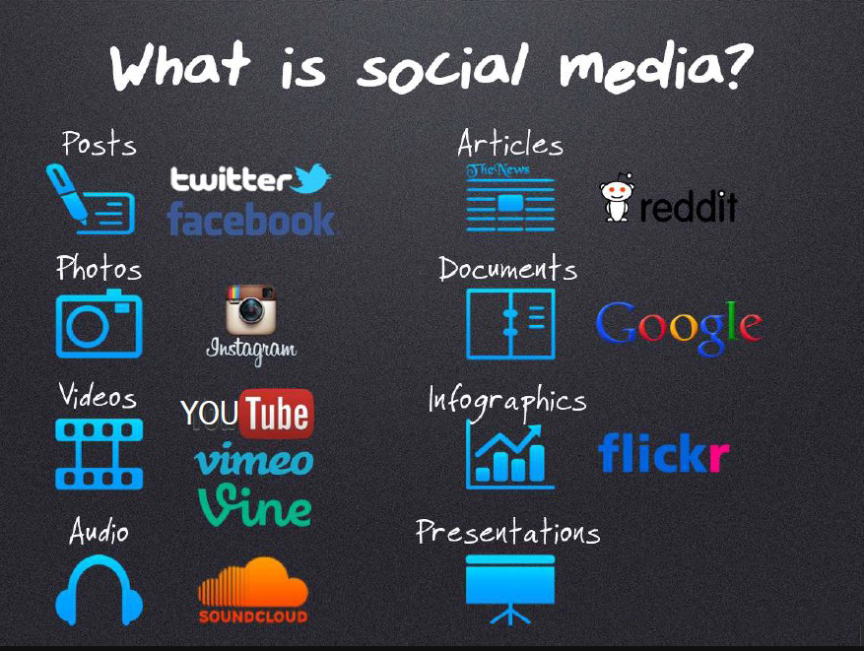
.

Slide 3

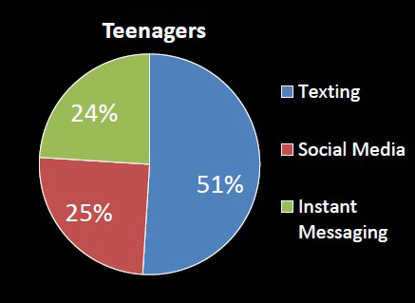
a
According to a Poll
22% of teenager log on to their favorite social media site more than 10 times a day.
More than half of adolescents log on to a social media site more than once a day.
Seventy-five percent of teenagers now own cell
phones.
.

Slide 4
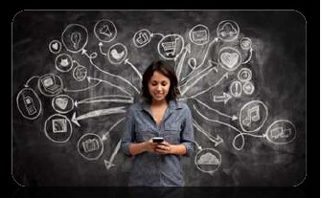
We are all aware that social media has had a tremendous impact on our culture, in business, on the world- at large.
What are some of the real powers, both positive and negativce that social media has vested in our hands?
Power of Social Media
Positive Powers
Negative Powers

Slide 5
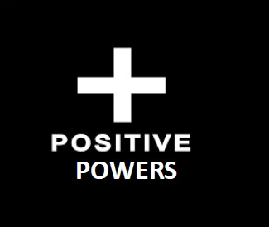
Positive Powers
Children & Adolescents
Enhanced Learning opportunities
Health Information and Issues
Powers in Business
Power in Politics
Non-Profit organization
Other Powers

Slide 6
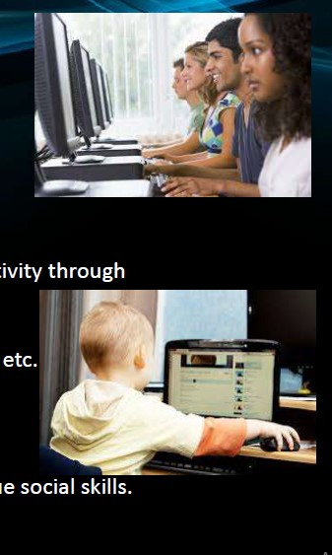
Positive Powers
1. Children & Adolescents :
Enhancement of individual and collective creativity through development and sharing.
Growth of ideas from creation of blogs, video etc.
Opportunities for community engagement.
Fostering of one’s individual identify and unique social skill.

Slide 7

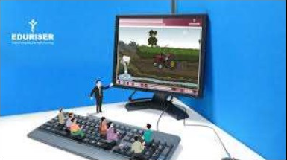

Positive Powers
2. Enhanced Learning Opportunities:
Students are using social media to connect with one another on homework and group projects.
Some schools successfully use blogs as teaching tools.

Slide 8


Positive Powers
3. Health Information and Uses:
Social Media helps to anonymously get information
about health issues.
A tool for creating awareness.
A tool to develop supportive networks of people
with similar conditions.

Slide 9




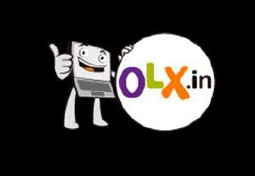
Positive Powers
4. Power in Business:
Communication between people and businesses.
It is a cheap and effective means to enhance brand
image and popularity.

Slide 10


Positive Powers
5. Power on Politics :
Social websites have played an important role in many
elections around the world, including in the U.S., Iran, and
India.
Social media has also served to rally people for a cause and
has inspired mass movements in many countries.

Slide 11
Positive Powers
6. Non-profit organization :
For their awareness campaigns.
Not to mention socially shared petitions from sites like
Causes.org are reaching hundreds of thousands of
people.

Slide 12
Positive Powers
7. Other Powers :
To re-connect with their old friends and
acquaintances or make new friends.
Share content and pictures.
Stay updated of the latest global and local
developments.
Learn about different cultures and societies.

Slide 13
Power Comes
with
Responsibilities

Slide 14
Negative Powers
There are downsides too to social media. Many introverts and socially
reclusive users place too much emphasis on virtual interaction, and ignore the real world outside.
Cyber Bullying And Online Harassment
Influence Of Advertisements On Buying
Relationships
4. ISIS

Slide 15
Negative Powers
1. Cyber Bullying and
Online Harassment :
Cyber bullying or online harassment is when a
person is tormented, threatened, harassed,
humiliated, embarrassed or otherwise
targeted by another person using the Internet,
interactive and digital technologies or mobile
phones.
“ What Goes Online Stays

Slide 16
Negative Powers
2. INFLUENCE OF ADVERTISEMENTS ON BUYING
1. Banner ads 2. Behavior ads 3. Demographic ads

Slide 17
Negative Powers
3. Relationships :
People don’t speak to their parents on the phone so much any
longer – they like statuses, share articles with each other and chat
about trifles of the day.
In 2020
In 2010

Slide 18
The Ugly Side : ‘War of Ideas’ Through Social Media
Almost One year ago, the Islamic State in Iraq
and Syria seized Iraq’s second largest city,
Mosul—its first major land grab. Despite the
fact that they outnumbered the attacking ISIS
force by 15-to-1. A militia of no more than
2,000 ISIS fighters captured a city of 1.5
million.

Slide 19
The Ugly Side : ‘War of Ideas’ Through Social Media
Now ISIS is using social media to expand its
war far beyond its borders.
Uploading videos on YouTube, passing
violated images through Instagram &
influencing teenagers through Twitter and
Facebook ,creating WhatsApp Group are
now the recent activities done by them.

Slide 20
Conclusion
It is up to each user to use social sites wisely to enhance their
professional and social life, and exercise caution to ensure they do
not fall victim to online dangers.
In the end, if you can keep your own life centred in reality and
use social networking as a small part of it, you should be just fine.
For those who can’t, it might be time to turn off the computer for
a bit and go for a walk.

